Slide 1
iPhone Application Development

Slide 2
From an idea to application
Idea
App

Slide 3
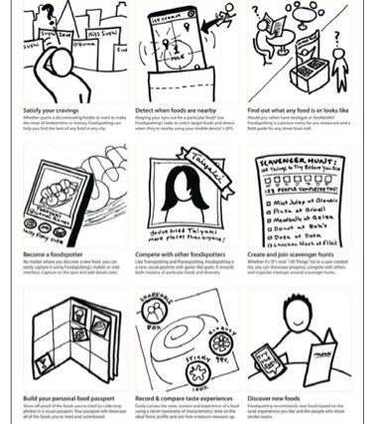

Slide 4
Methodology
Define Requirement
Design
Implementation
Testing
Submit to App Store

Slide 5
How to gather requirement?

Slide 6
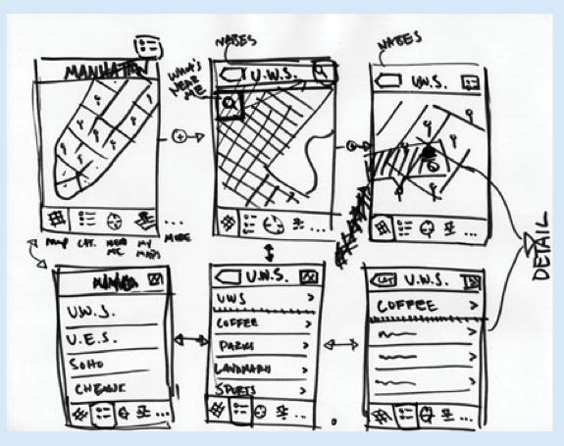
Requirement

Slide 7
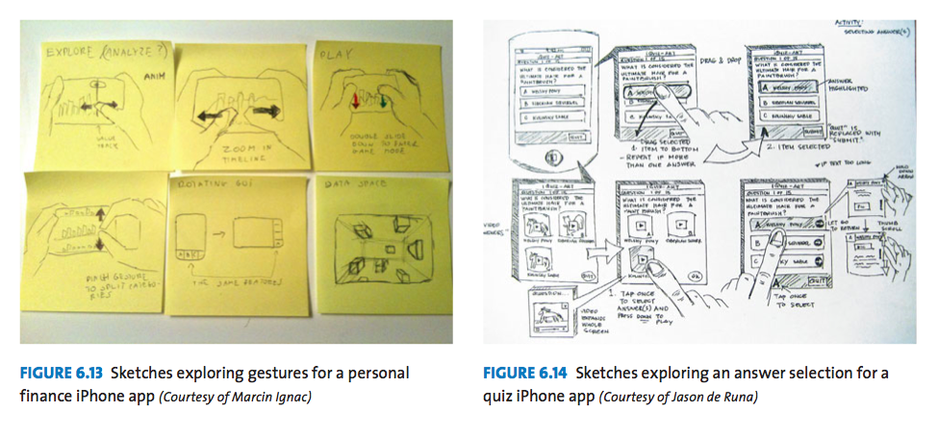
Requirement

Slide 8
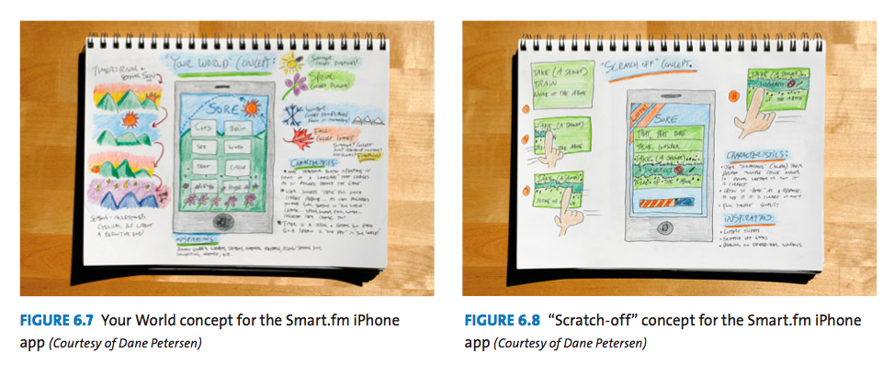
Requirement

Slide 9
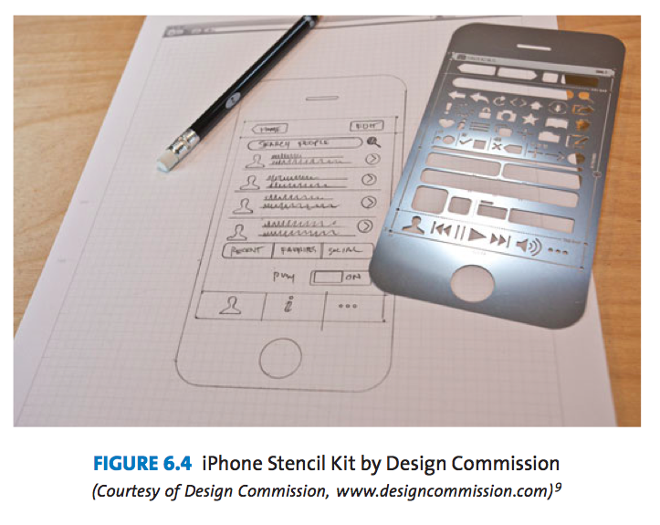
Requirement

Slide 10
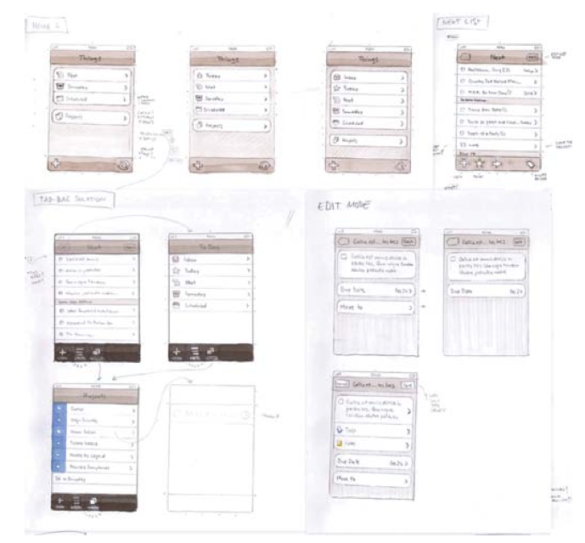

Slide 11
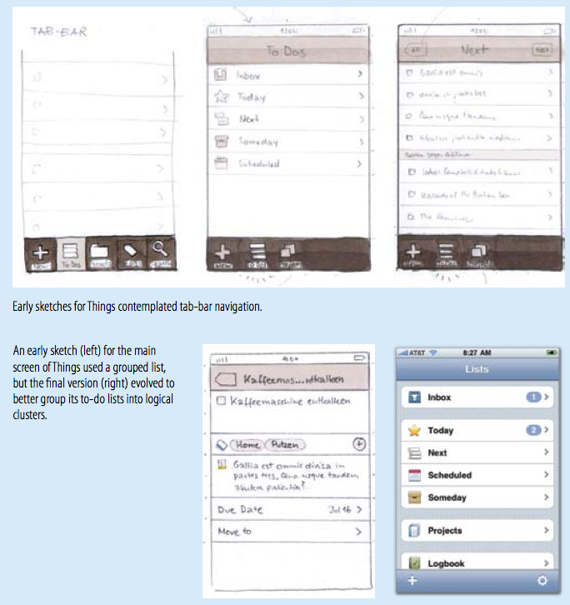

Slide 12
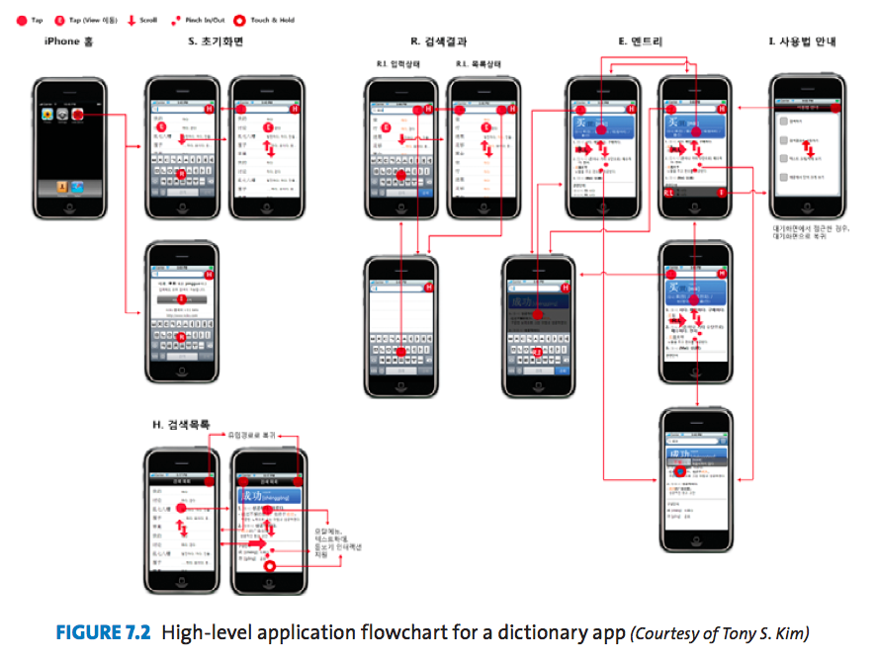

Slide 13
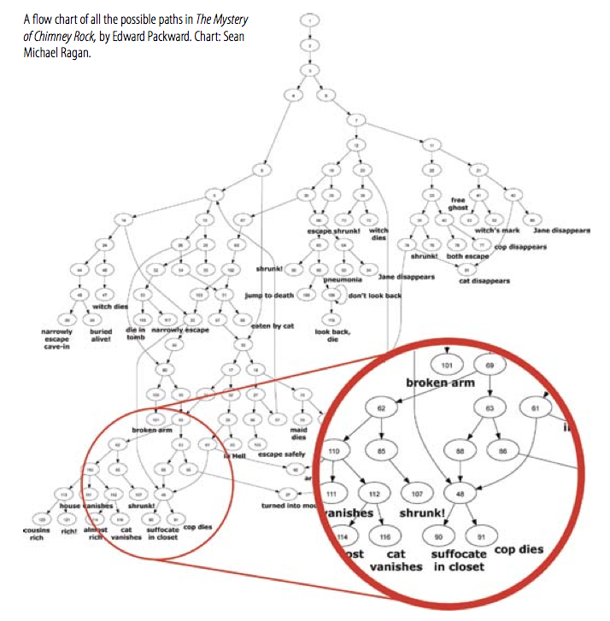

Slide 14
Questions
How to define your navigation Model?

Slide 15
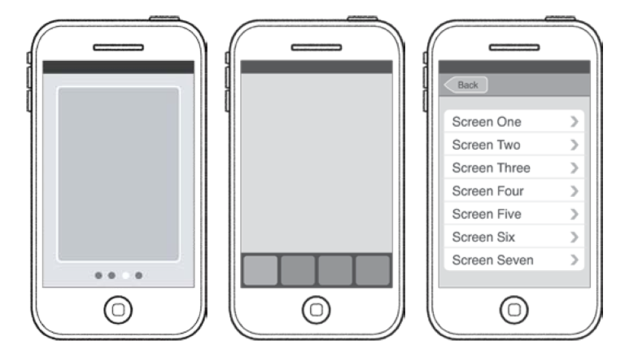

Compare 3 Common Navigation Models
Notes:
1st – Flat Page
Pros
Quick and focused content
For Casual Browsing of Screens
Easy to use and familiar wipe gesture
Cons
Can’t Jump to any screen other than immediate neighbors
Page Indicator limited to 20 dots
Not good for lengthy content
Overlook and miss app additional screens
2nd – Tab Bar
Pros
One-Tap to all main features
Clearly label menu shows current location
Cons
Only 5 tabs can be displayed at once
Absorbs significant screen space
3rd – Tree Structure
Pros
Scale well for large numbers of categories
Outline Organization easily understood
Direct interaction with content
Well for user-customized categories
Cons
Primary features are listed only on top-level screen, unlike tab bar’s always-on display
Inefficient switching among main features or categories

Slide 16
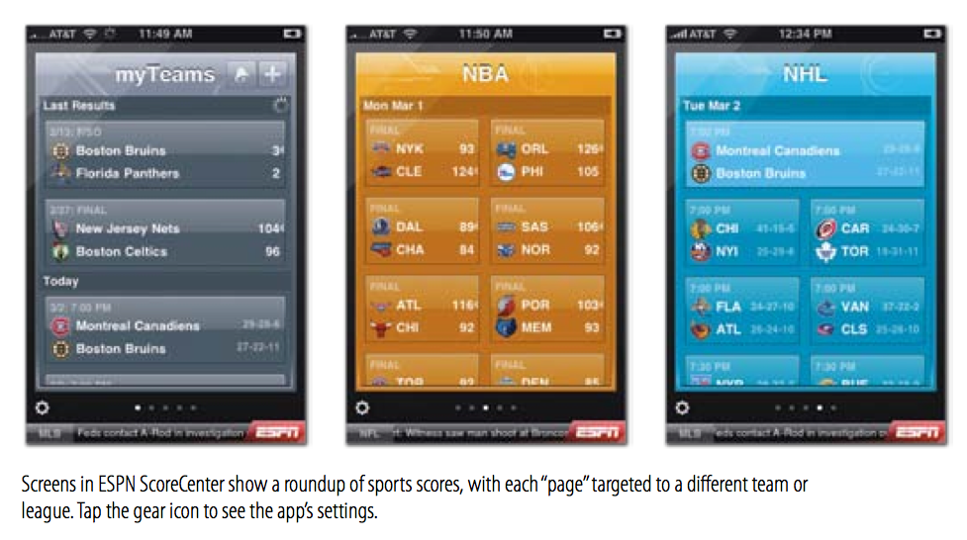
Sample

Slide 17
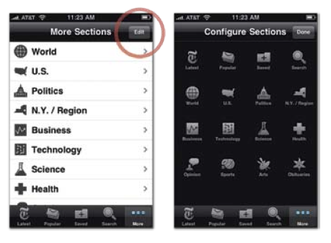
Sample

Slide 18
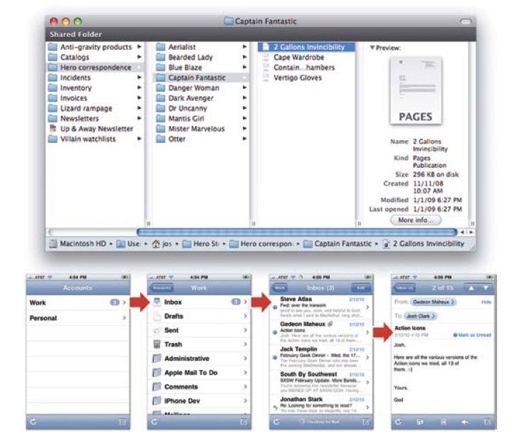
Sample

Slide 19
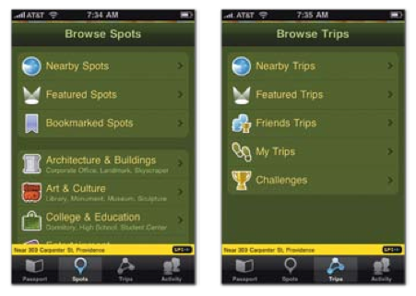
Combine Model

Slide 20
Design

Slide 21
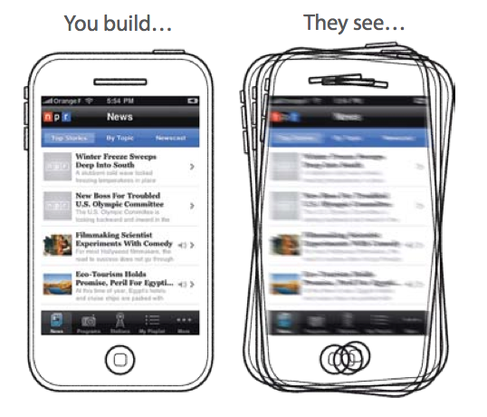
The Truth

Slide 22
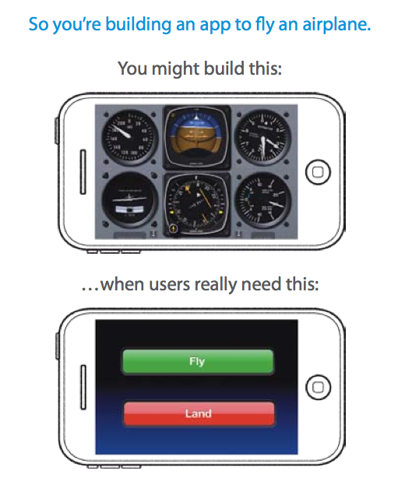

Slide 23
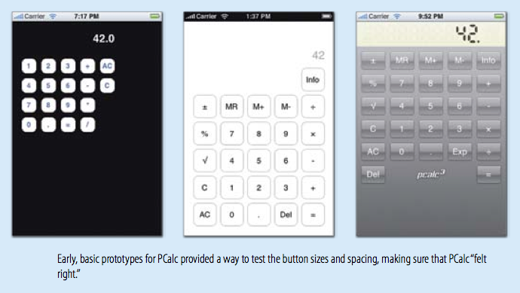
Design

Slide 24
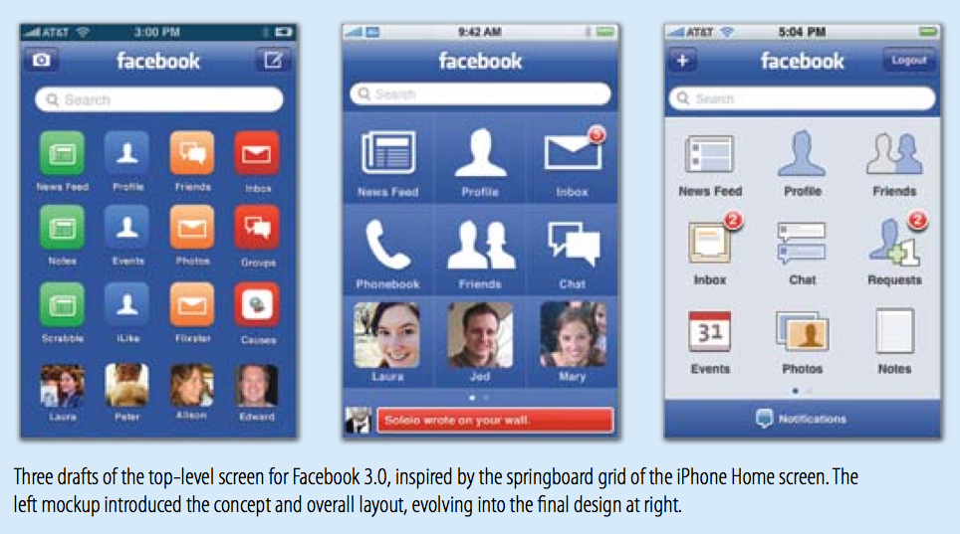
Design

Slide 25
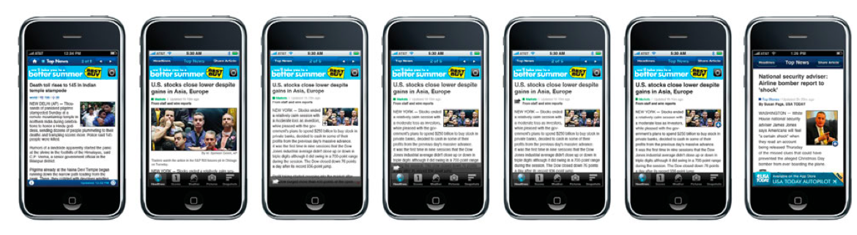

Slide 26
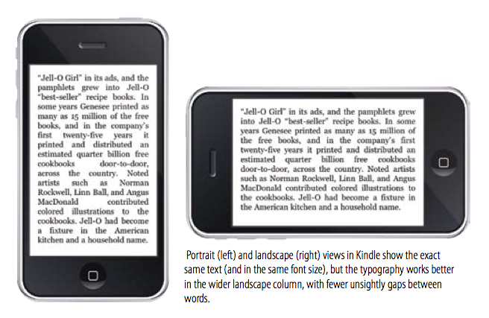
Design

Slide 27
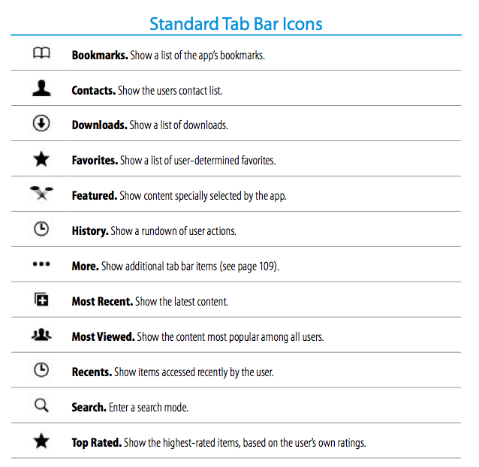
Standard Images

Slide 28
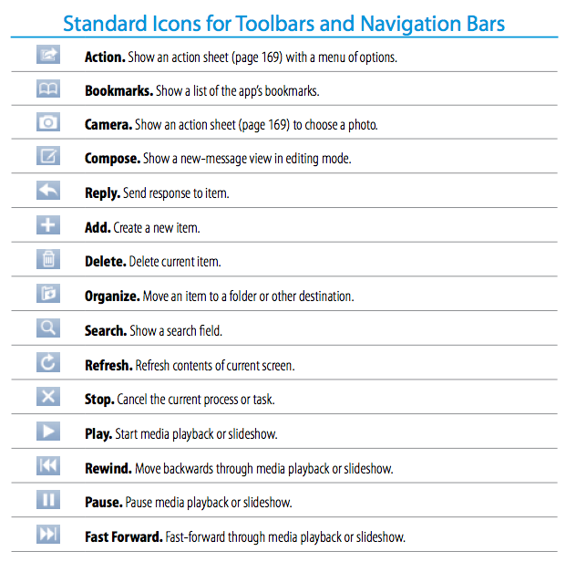

Slide 29

Questions
What is this?

Slide 30
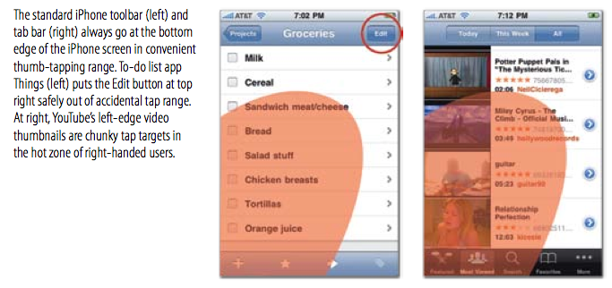
Answer

Slide 31
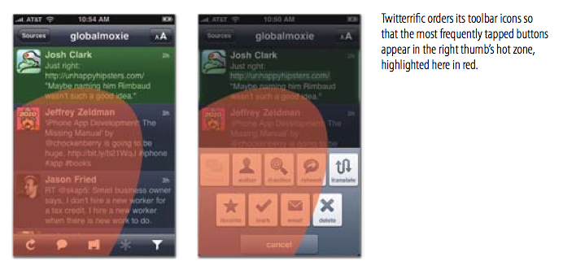
Answer

Slide 32

Showcase

Slide 33
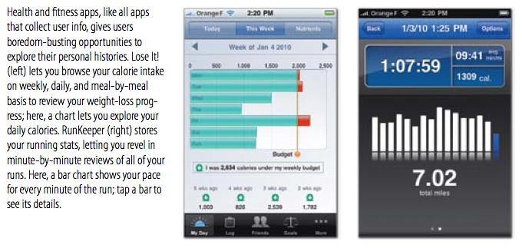
Showcase

Slide 34
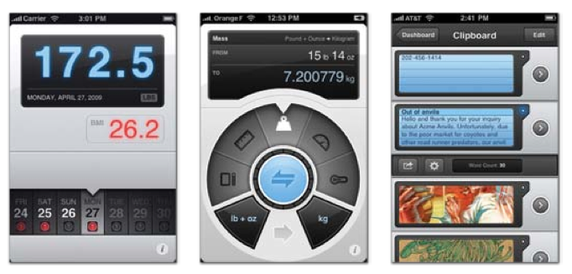
Showcase

Slide 35
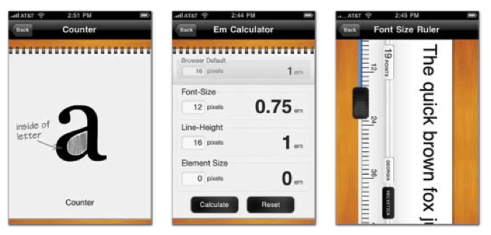
Showcase

Slide 36
Question & Answer

